Slide 1
INVEST ME
Make your future..
www.investme.az

Slide 2
Problem:
Lack of networking
Lack of financial assistance
Specialization problem
Loyality problem

Slide 3
Solution:
Creating two-sided information and connection system between investors and youth

Slide 4
Segmentation:
B2C ( Business to Consumers)

Slide 5
4P
Product (Service)
Connection
Qualified employees (based on this connection)
Loyalty
Networking.
Price
Fixed fee 2% from each investment
Payments for advertising.

Slide 6
4P
Place
Online platform
Mini office for team
Promotion
Social networks
Events( exhibition, meetings)
Design material (fliers and etc.)
Communication channels.

Slide 7
Team
Project manager – Sevil Hajiyeva
General manager – Pinar Jabrailova
Financial manager – Dilavar Karimli
Marketing manager – Ulviyya Akhundova
External relation manager – Aytan Ibrahimova
IT manager – Amrah Ismayilzadeh

Slide 8
Duration: pilot – 2 years.
Founders: members of team.
Partners: Private companies, investors and non-governmental organizations

Slide 9
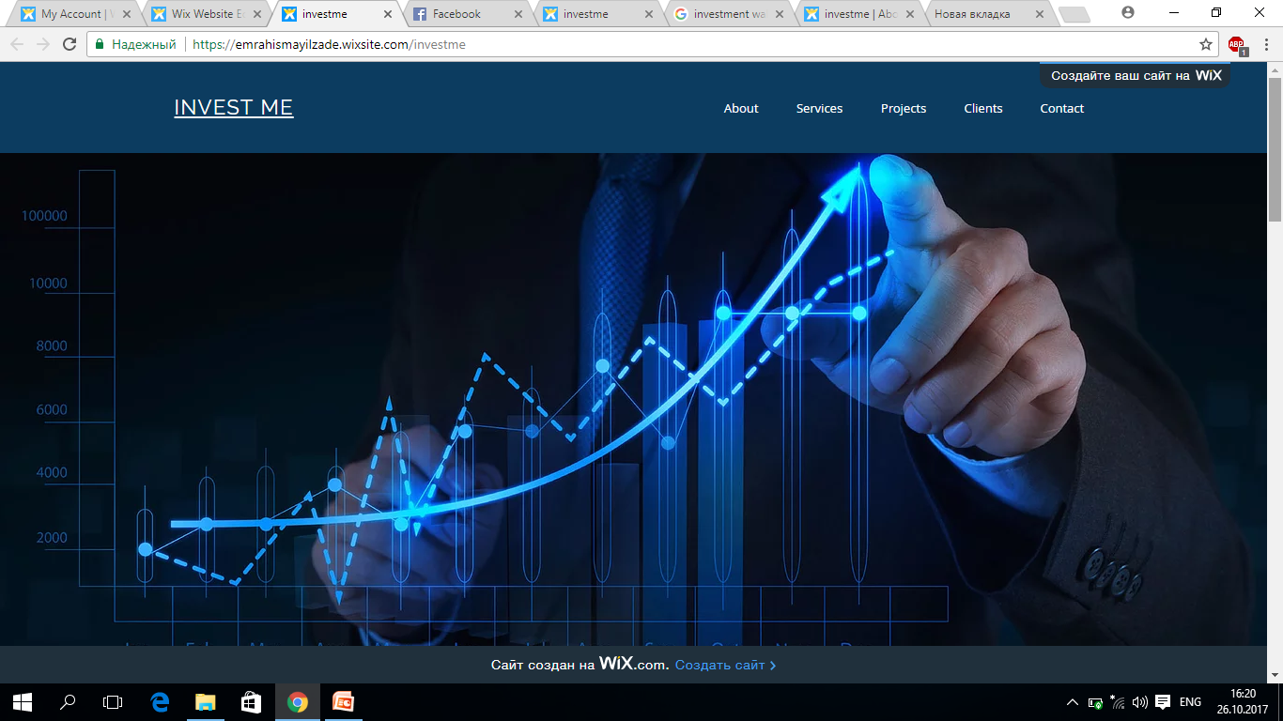
www.investme.az

Slide 10
THANKS FOR ATTENTION ☺

